Slide 1
Text Analysis Threat Level Prediction
In this task we need analyse text & perform EDA to build model to predict the threat level of a text on the basis of what is written in it.

Slide 2
Steps taken before EDA was performed
Imported necessary libraries for task to be completed.
Loaded dataset on jupyter notebook using pandas library.
Created the new target column named Threat_level by merging 6 target columns
Checked dimensions of both datasets train with 159571 rows & 8 columns & test with 153164 rows & 2 columns.
Checked description of dataset which gives information of mean, min value, max value, etc of every column in dataset which contains continuous data in it.
Checked presence of null values in dataset & no null values were present in it.

Slide 3
Exploratory Data Analysis

Slide 4
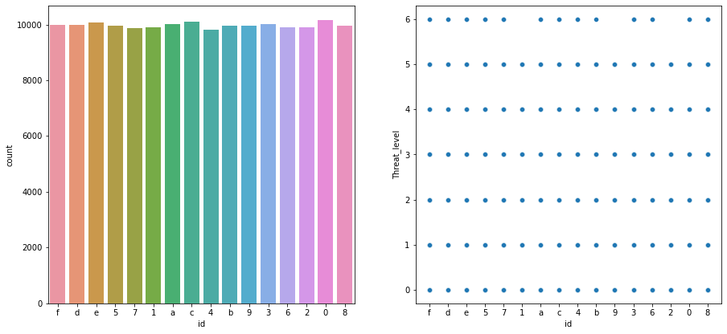
1. id
Checked unique values of the column.
There was no null value present in the column.
From visualization we conclude most data is present in 2 categories which are C & 0 & every threat_level is present in every category of id except of threat_level 6 which is not present in 3 categories of id which are 1, 9 & 2.

Slide 5
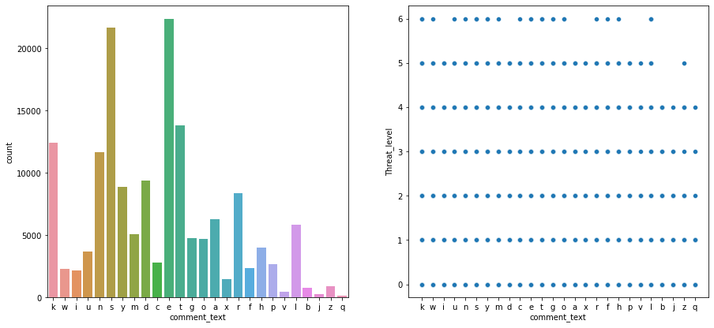
2. comment_text
Checked unique values of the column.
There was no null value present in the column.
From visualization we concluded that most data is present in e category & every category of threat_level is present in every category of text_comment except of 2 categories of threat_level which are 5 & 6. 5th category is not present in b, j, & q category of comment_text & 6th category is not present I, d, a, x, p, v, b, j, z & q category of comment_text

Slide 6
Applying GridSearchCV
We splitted train dataset using train_test_split to check various models performance on it before choosing the best model to apply it on test dataset.
We checked 5 models on train dataset which are (Logistic Regression Model, Decision Tree Classification Model, Random Forest Classification Model, Bagging Classification Model & AdaBoosting Classification Model) for their performance to findout the best suited model.
Then one by one we applied GridSearchCV on each model to find best hyper parameter tuning while model is best.
After applying GridSearchCV on every model we conclude that every model is giving same train accuracy : 0.9230 & test accuracy : 0.9207. So we randomly choose Decision Tree Classification Model with hyper parameter combination of (max_depth : 1, min_samples_leaf : 1, min_samples_split : 2)

Slide 7
Applying Model on Dataset
Chose Decision Tree Classification Model & made it ready by tuning hyper parameter.
After this we prepared test dataset for prediction.
After tuning hyper parameter applied model on test dataset to make prediction.
After making prediction we made dataframe of prediction value & concatenate it with test dataset.
We could not apply metrices as there was no target variable present in test dataset.

Slide 8
THE END

